Slide 1
R building model

Slide 2
R Software Packages
Hmisc: Functions for data analysis, high-level graphics, utility operations, computing sample size and power, importing datasets, imputing missing values, advanced table making, variable clustering, character string manipulation, conversion of S objects to LaTeX code, and recoding variables
rms: Functions for regression modeling, testing, estimation, validation, graphics, prediction, and typesetting by storing enhanced model design attributes in the fit. rms is a collection of 229 functions that assist and streamline modeling, especially for biostatistical and epidemiologic applications

Slide 3
R Software Packages
library(foreign)
library(caret)
library(car)
library(nlme)
library(rms)
library(e1071)
library(BiodiversityR)
library(moments)

Slide 4
Import data
#data <- read.csv(file.choose())
data <- read.csv("*/model.csv")
R modelling tutorial
https://github.com/jinfuchen/R-model
Notes:
# Load data into data frame ‘ data ’

Slide 5
Dataframe handle
1. dplyr
filter, select, group_by, join, summarise, ddply
2. tidyr
gather, spread, separate, unite
3. ggplot2
ggplot, geom_abline, geom_point, geom_histogram
http://hadley.nz/

Slide 6
1.Examine data
names(data) #查看属性
summary(data) #查看分布
skewness(data$post_bugs) #数据倾斜性
kurtosis(data$post_bugs) #数据是否满足正太分布
Notes:
the skewness is a measure of symmetry. As a rule, negative skewness indicates that the mean of the data values is less than the median, and the data distribution is left-skewed. Positive skewness would indicate that the mean of the data values is larger than the median, and the data distribution is right-skewed.
The normal distribution has zero kurtosis

Slide 7
2.Normality adjustment
1.>skewness(data$post_bugs)
[1] 10.36102 #right-skewed
2. > kurtosis(data$post_bugs)
[1] 144.8113 #leptokurtic
3. log transformation [ln(x + 1)] to lessen the skew
log10(data+1)
Notes:
OLS expects that the dependent variable is normally distributed.
If we find that the distribution is skewed, we apply a log transformation [ln(x + 1)] to lessen the skew

Slide 8
3.Estimate Budget for Degrees of Freedom
A critical concern is that of over-fitting. Calculate a budget of degrees of freedom that a dataset can support before attempting to fit a model.
>floor (nrow(data)/15)
[1] 89 #support 89 independent variables
Notes:
Overfitting may creep into models that use more degrees of freedom (e.g., explanatory variables) than a dataset can support.
Hence, it is pragmatic to calculate a budget of degrees of freedom that a dataset can support before attempting to fit a model
we budget n/15 degrees of freedom for our defect models, where n is the number of rows
data can support 89 (1,339/15) degrees of freedom.

Slide 9
Drop data
Remove inf data
drop1<-c("comp","subsystem","mean_discussion","mean_revspeed")
data <- data[,!(names(data) %in% drop1)]
Drop class data
drop2 <- c("post_bugs")
independant <- data[,!(names(data) %in% drop2)]
Notes:
###drop categorical and data with inf

Slide 10
4.Correlation analysis
correlations <- cor(independant, method="spearman")
#spearman or pearson
highCorr <- findCorrelation(correlations, cutoff = .75)
low_cor_names=names(independant[, -highCorr])
low_cor_data= independant[(names(independant) %in% low_cor_names)]
Notes:
计算属性关联性
可以选择不同的计算方法，一般使用皮尔逊和斯皮尔曼

Slide 11
Variable clustering analysis
Variable clustering analysis to construct a hierarchical overview of the correlation among the explanatory variables
vcobj = varclus( ~., data = independant, trans ="abs")
plot(vcobj)
abline(h=1-0.75, col="red")
Notes:
聚类，直观地看各个属性之间的关联性

Slide 12
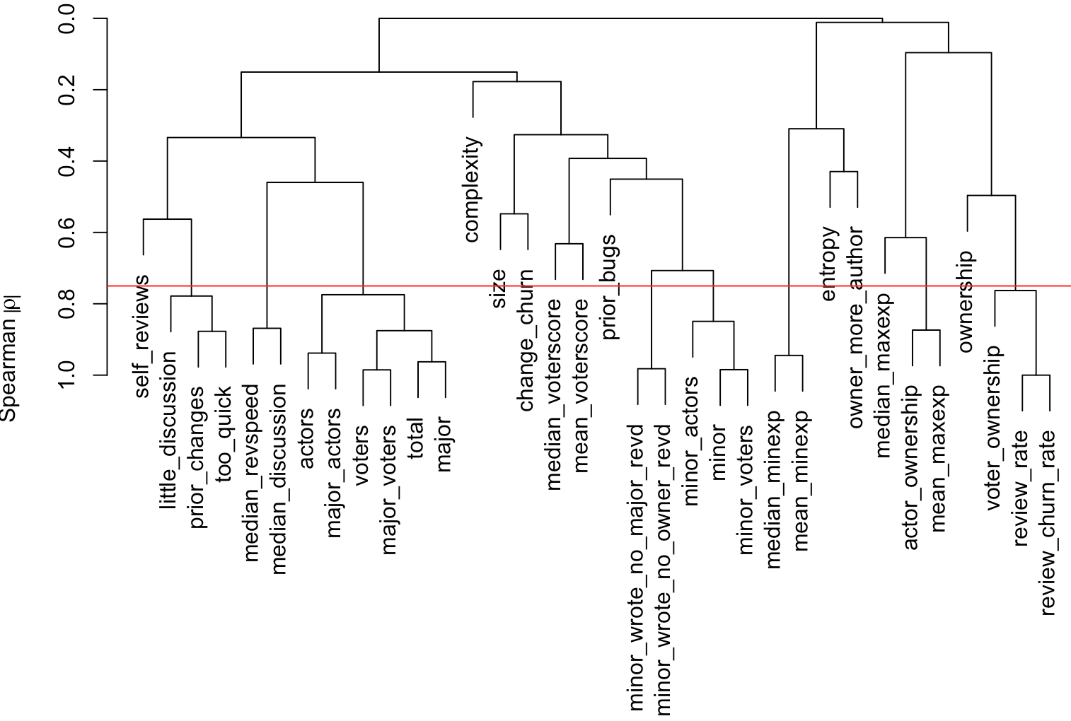
Variable clustering analysis
Notes:
聚类，直观地看各个属性之间的关联性
variable clustering analysis to construct a hierarchical overview of the correlation among the explanatory variables

Slide 13
Redundancy analysis
The redundancy analysis would consider a metric redundant if it can be predicted from a combination of all other metrics.
dataforredun=low_cor_data
redun_obj = redun(~. ,data = dataforredun ,nk =0)
after_redun= dataforredun[,!(names(dataforredun) %in% redun_obj)]
Notes:
We calculate the R2 of each model and if the R2 is largerthan a threshold (0.9) [49], the current dependent variable is
considered redundant.

Slide 14
Model building
Linear model
form <- as.formula(paste("post_bugs~",paste(paste("rcs(",names(after_redun),",0)"),collapse="+")))
fit = ols(form, data = data , x=T ,y=T )
Notes:
y = β0 +β1x1 +β2x2 +···+βnxn

Slide 15
Model building
randomForest
rf.fit <- randomForest(x=after_redun, y=data$post_bugs, ntree=500, importance=TRUE)

Slide 16
Model validation
predictions <- predict(rf.fit, data,type="response")
TP = sum((predictions>0.5) & (data$post_bugs>0))
precision = TP / sum((predictions>0.5))
recall = TP / sum(data$post_bugs>0)
Notes:
External validation using new test data generated using different instruments, done by an independent research team

Slide 17
AUC
data imbalanced
data is highly skewed since the majority of the tests do not manifest performance regression.
The AUC is the area under the ROC curve which indicates the performance of a binary model as its discrimination is varied.
Notes:
AUC which allows us to measure the overall ability of our model to discriminate tests with performance regression and without performance regression.

Slide 18
AUC
Model validation
roc_obj <- roc(true_category, predict_value)
auc <- auc(roc_obj)
Notes:
AUC which allows us to measure the overall ability of our model to discriminate tests with performance regression and without performance regression.

Slide 19
Assessment of model stability
num_iter <- 1000
validate(fit, B=num_iter)
# Run the bootstrapped optimism calculations

Slide 20
Estimate power of variable
anova(fit , test ="Chisq")
Example
fit <- glm(y~x1+x2+x3),family=”binomial”)
Running
1.glm(y~1, family=”binomial”) vs. glm(y~x1, family=”binomial”)
2.glm(y~x1, family=”binomial”) vs glm(y~x1+x2, family=”binomial”)
3.glm(y~x1+x2, family=”binomial”) vs glm(y~x1+x2+x3, family=”binomial”)
Notes:
The larger the Wald chi χ2 value, the larger the impact that a particular explanatory variable has on a model’s performance.

Slide 21
Estimate power of variable
importance <- importance(rf.fit, type=1, class="TRUE")

Slide 22
data rebalance
Up-sampling
class_data <- as.factor(class_data)
upsample_data <- upSample(x = data, y = class_data)

Slide 23
data rebalance
SMOTE
form_smote <- as.formula(paste(class,"~."))
class1 <- sum(class_data)
class0 <- length(class_data) - class1
over_param <- (class0/class1)*100
under_param<- (10000/over_param+100)
smote_data <- SMOTE(form_smote, data = data, k = 5, perc.over = over_param, perc.under = under_param)

Slide 24
Hypothesis test-significant difference
Compare mean
T-test
Compare order
wilcox-test
Compare distribution
ks-test
…

Slide 25
Effect size-How big difference?
cohen.d
Cliff’s delta

